Slide 1
Data exploration and visualization

Slide 2
What is data exploration?
A preliminary exploration of the data to better understand its characteristics.
Key motivations of data exploration include
Helping to select the right tool for preprocessing or analysis
Making use of humans’ abilities to recognize patterns
People can recognize patterns not captured by data analysis tools

Slide 3
Techniques Used In Data Exploration
In our discussion of data exploration, we focus on
Summary statistics
Visualization

Slide 4
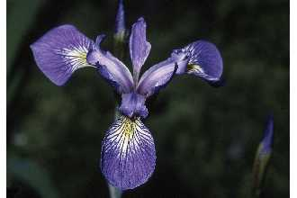
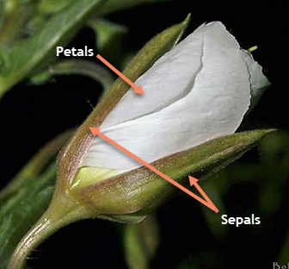
Iris Sample Data Set
Many of the exploratory data techniques are illustrated with the Iris Plant data set.
Can be obtained from the UCI Machine Learning Repository http://www.ics.uci.edu/~mlearn/MLRepository.html
From the statistician Douglas Fisher
Three flower types (classes):
Setosa
Virginica
Versicolour
Four (non-class) attributes
Sepal width and length
Petal width and length
Virginica. Robert H. Mohlenbrock. USDA NRCS. 1995. Northeast wetland flora: Field office guide to plant species. Northeast National Technical Center, Chester, PA. Courtesy of USDA NRCS Wetland Science Institute.
Sepal : lá đài
Petal : cánh hoa

Slide 5
Summary Statistics
Summary statistics are numbers that summarize properties of the data
Summarized properties include frequency, mean and standard deviation
Most summary statistics can be calculated in a single pass through the data

Slide 6
Frequency and Mode
The frequency of an attribute value is the percentage of time the value occurs in the data set
For example, given the attribute ‘gender’ and a representative population of people, the gender ‘female’ occurs about 50% of the time.
The mode of a an attribute is the most frequent attribute value
The notions of frequency and mode are typically used with categorical data

Slide 7
Percentiles
For continuous data, the notion of a percentile is more useful.
Given an ordinal or continuous attribute x and a number p between 0 and 100, the pth percentile is a value of x such that p% of the observed values of x are less than .
For instance, the 50th percentile is the value such that 50% of all values of x are less than .

Slide 8
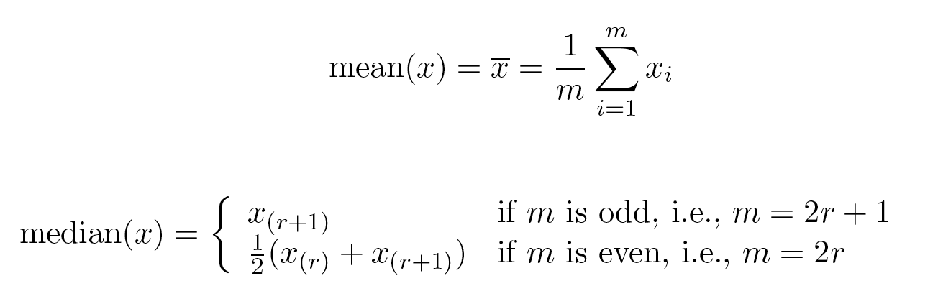
Measures of Location: Mean and Median
The mean is the most common measure of the location of a set of points.
However, the mean is very sensitive to outliers.
Thus, the median or a trimmed mean is also commonly used.

Slide 9
Measures of Spread: Range and Variance
Range is the difference between the max and min
The variance or standard deviation is the most common measure of the spread of a set of points.

Slide 10
Visualization
Visualization is the conversion of data into a visual or tabular format so that the characteristics of the data and the relationships among data items or attributes can be analyzed or reported.
Visualization of data is one of the most powerful and appealing techniques for data exploration.
Humans have a well developed ability to analyze large amounts of information that is presented visually
Can detect general patterns and trends
Can detect outliers and unusual patterns

Slide 11
Representation
Is the mapping of information to a visual format
Data objects, their attributes, and the relationships among data objects are translated into graphical elements such as points, lines, shapes, and colors.
Example:
Objects are often represented as points
Their attribute values can be represented as the position of the points

Slide 12
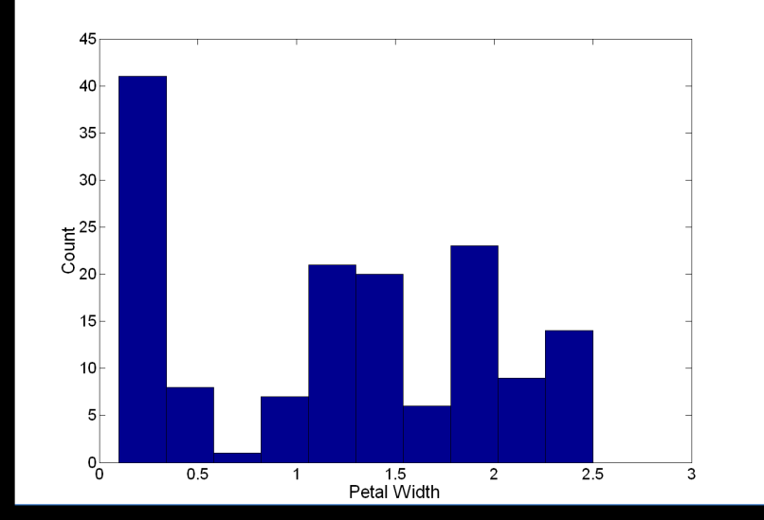
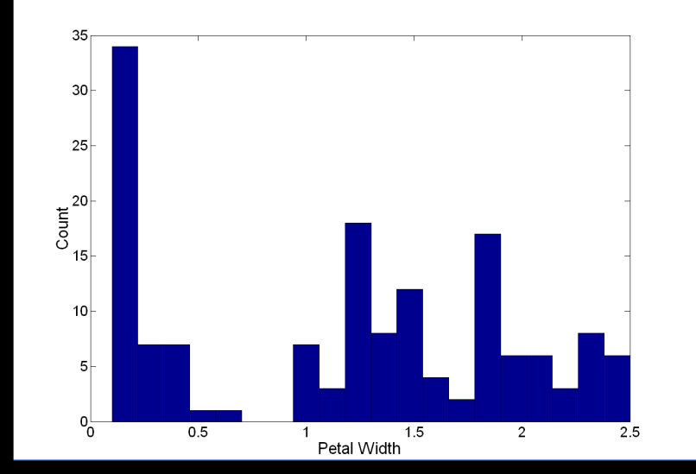
Visualization Techniques: Histograms
Histogram
Usually shows the distribution of values of a single variable
Divide the values into bins and show a bar plot of the number of objects in each bin.
The height of each bar indicates the number of objects
Shape of histogram depends on the number of bins
Example: Petal Width (10 and 20 bins, respectively)

Slide 13
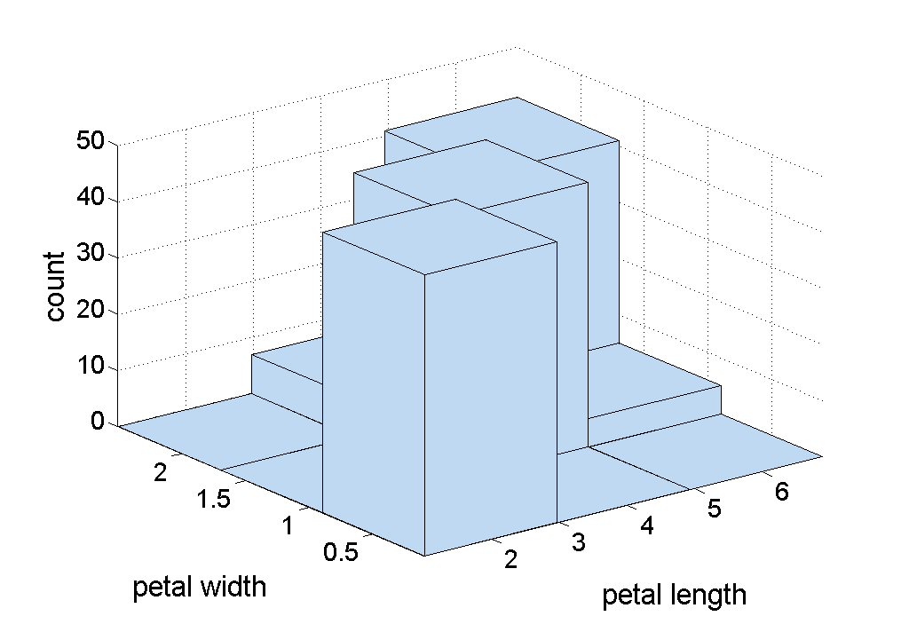
Two-Dimensional Histograms
Show the joint distribution of the values of two attributes
Example: petal width and petal length
What does this tell us?

Slide 14
Visualization Techniques: Box Plots
outlier
Box Plots
Invented by J. Tukey
Another way of displaying the distribution of data
Following figure shows the basic part of a box plot
90th percentile
75th percentile
50th percentile
25th percentile
10th percentile

Slide 15
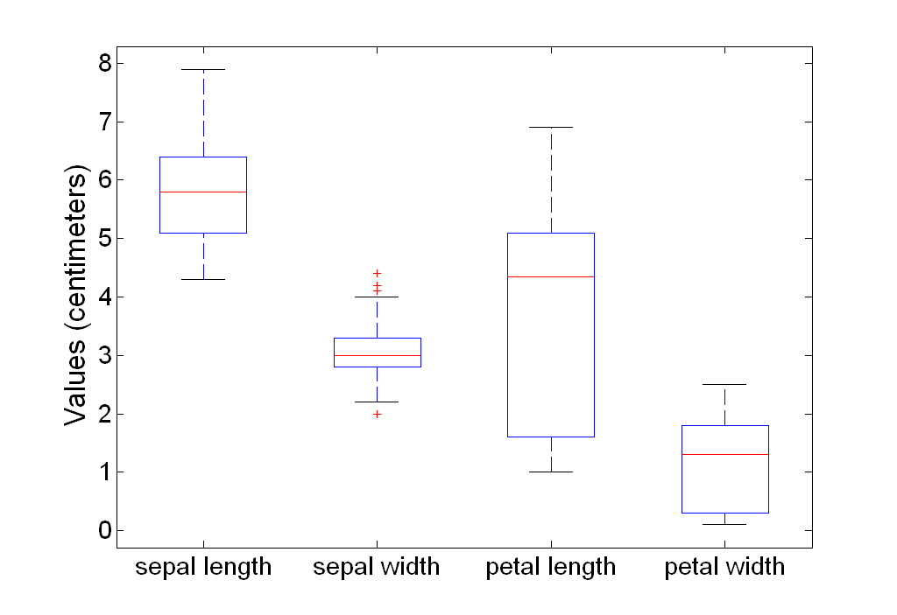
Example of Box Plots
Box plots can be used to compare attributes

Slide 16
Visualization Techniques: Scatter Plots
Scatter plots
Attributes values determine the position
Two-dimensional scatter plots most common, but can have three-dimensional scatter plots
Often additional attributes can be displayed by using the size, shape, and color of the markers that represent the objects
It is useful to have arrays of scatter plots can compactly summarize the relationships of several pairs of attributes
See example on the next slide

Slide 17
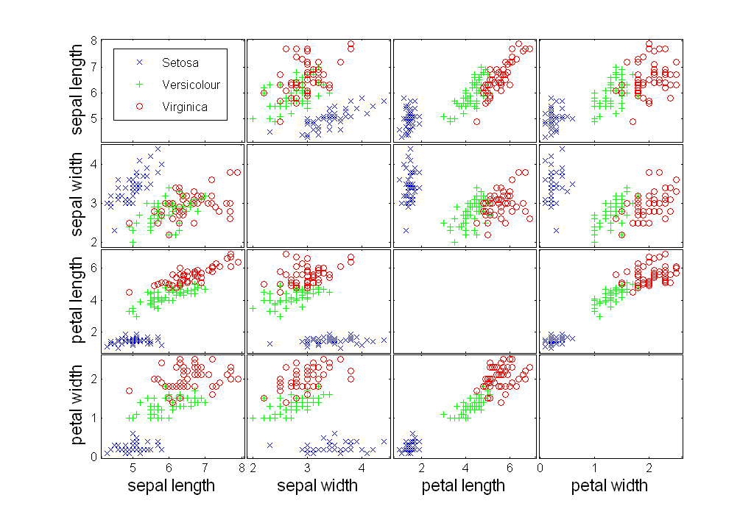
Scatter Plot Array of Iris Attributes

Slide 18
Visualization Techniques: Contour Plots
Contour plots
Useful when a continuous attribute is measured on a spatial grid
They partition the plane into regions of similar values
The contour lines that form the boundaries of these regions connect points with equal values
The most common example is contour maps of elevation
Can also display temperature, rainfall, air pressure, etc.
An example for Sea Surface Temperature (SST) is provided on the next slide

Slide 19
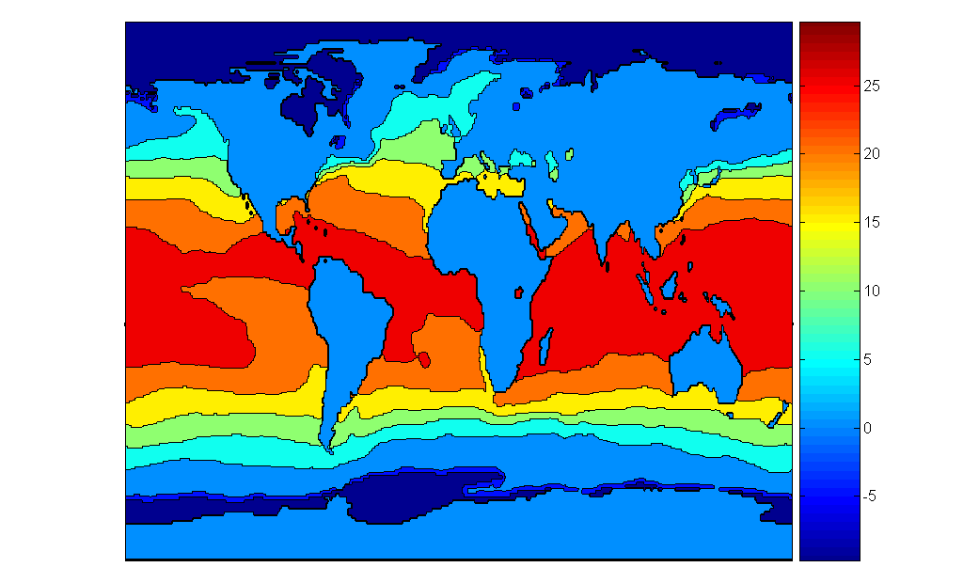
Contour Plot Example: SST Dec, 1998
Celsius

Slide 20
Visualization Techniques: Matrix Plots
Matrix plots
Can plot the data matrix
This can be useful when objects are sorted according to class
Typically, the attributes are normalized to prevent one attribute from dominating the plot
Plots of similarity or distance matrices can also be useful for visualizing the relationships between objects
Examples of matrix plots are presented on the next two slides

Slide 21
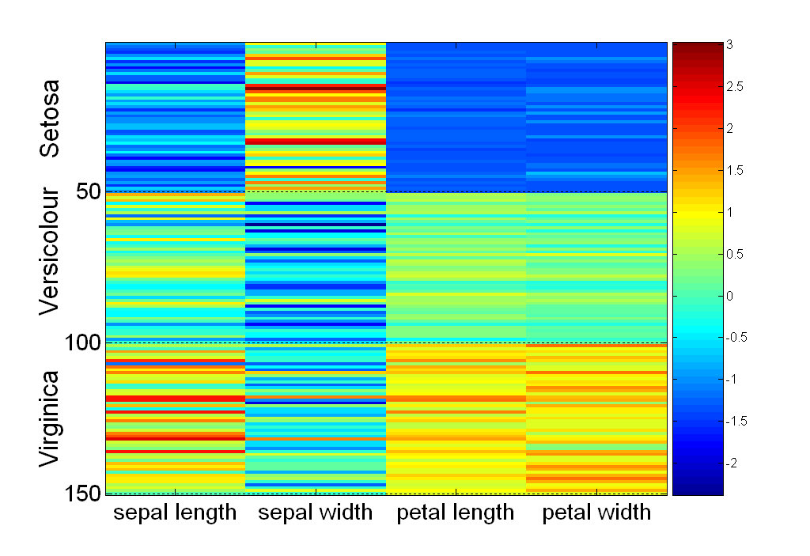
Visualization of the Iris Data Matrix (HeatMap)
standard
deviation

Slide 22
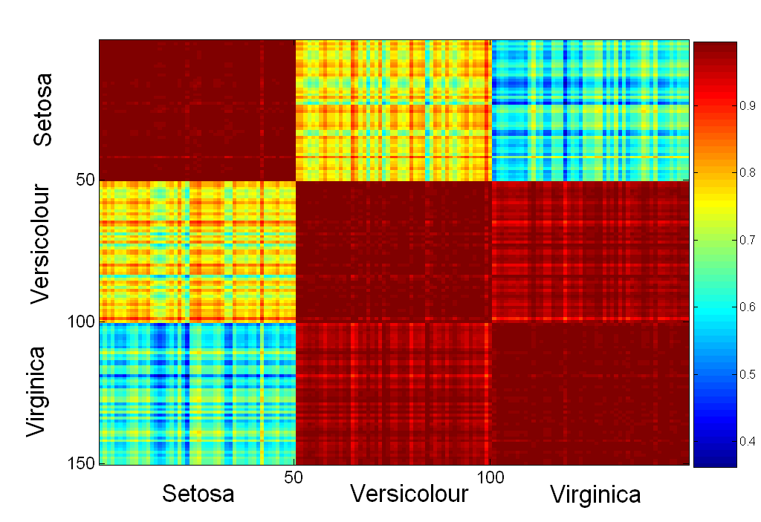
Visualization of the Iris Correlation Matrix

Slide 23
Visualization Techniques: Parallel Coordinates
Parallel Coordinates
Used to plot the attribute values of high-dimensional data
Instead of using perpendicular axes, use a set of parallel axes
The attribute values of each object are plotted as a point on each corresponding coordinate axis and the points are connected by a line
Thus, each object is represented as a line
Often, the lines representing a distinct class of objects group together, at least for some attributes
Ordering of attributes is important in seeing such groupings

Slide 24
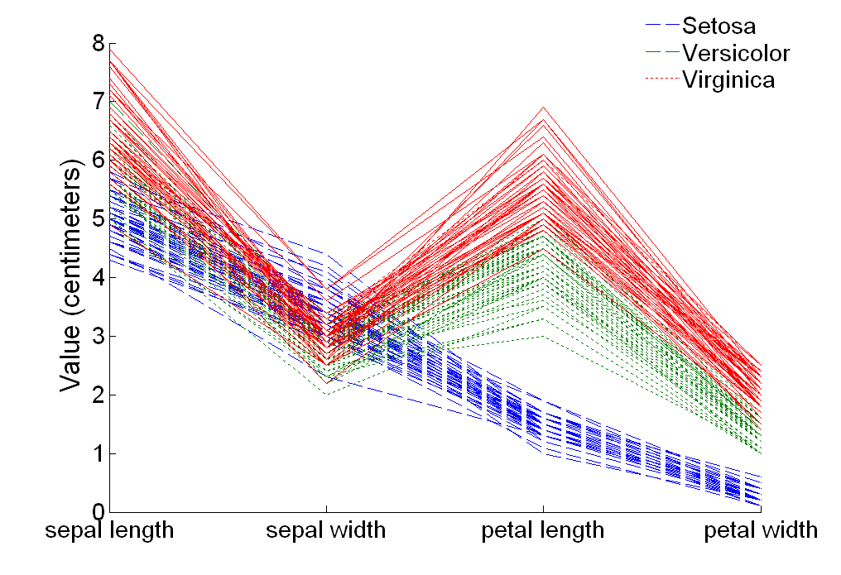
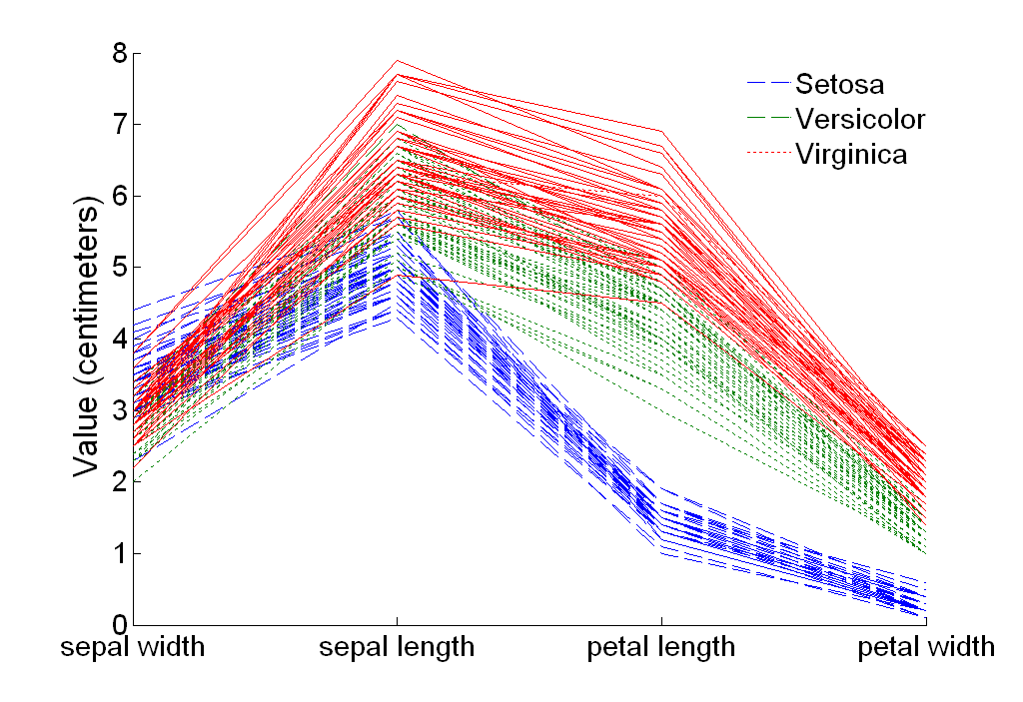
Parallel Coordinates Plots for Iris Data

Slide 25
Other Visualization Techniques
Star Plots
Similar approach to parallel coordinates, but axes radiate from a central point
The line connecting the values of an object is a polygon
Chernoff Faces
Approach created by Herman Chernoff
This approach associates each attribute with a characteristic of a face
The values of each attribute determine the appearance of the corresponding facial characteristic
Each object becomes a separate face
Relies on human’s ability to distinguish faces

Slide 26
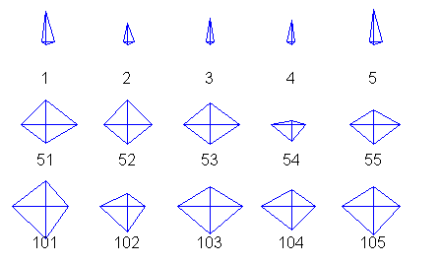
Star Plots for Iris Data
Setosa
Versicolour
Virginica

Slide 27
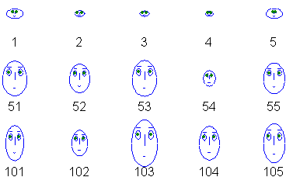
Chernoff Faces for Iris Data
Setosa
Versicolour
Virginica

Slide 28

Cám ơn
sự theo dõi

